Slide 1

Exploratory Data Analysis
G2M insight for Cab Investment firm
Name : Saad Bin Munir

Slide 2

Agenda
Executive Summary
Problem Statement
Data Exploration
EDA Analysis
Conclusions
Recommendations

Slide 3
Problem Statement
Due to remarkable growth in the Cab Industry in last few years and multiple key players in the market, XYZ (A private firm in US) is planning to invest in Cab industry and as per their Go-to-Market(G2M) strategy they want to understand the market before taking final decision.
In this project we will use multiple data sets that contain information on 2 cab companies and use that information to identify the right company to make their investment.

Slide 4
Data Exploration
The datasets were already clean and had no duplicate values preset.
The datasets contains data of three years ranging from 2016 to 2018.
Univariate outlier analysis was carried out to find out the information about variables.
All four datasets were combined in meaningful way in order to use them for analysis.
Filename | Number of entries | Number of attributes
Cab_Data.csv | 359392 | 7
Customer_ID.csv | 49171 | 4
Transaction_ID.csv | 440098 | 3
City.csv | 20 | 3

Slide 5
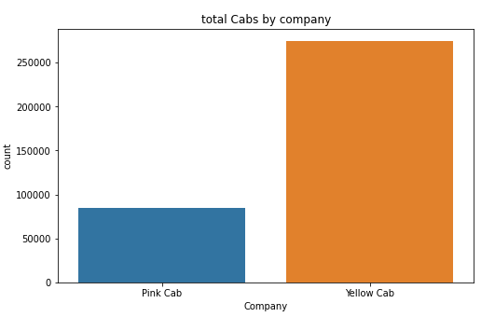
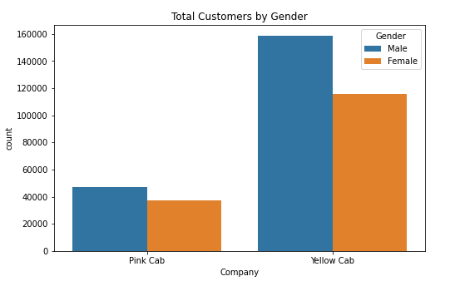
EDA: Company Performance and Gender
Most of the travelers prefer yellow cab over pink cab.
Both companies have more proportion of male travelers.

Slide 6
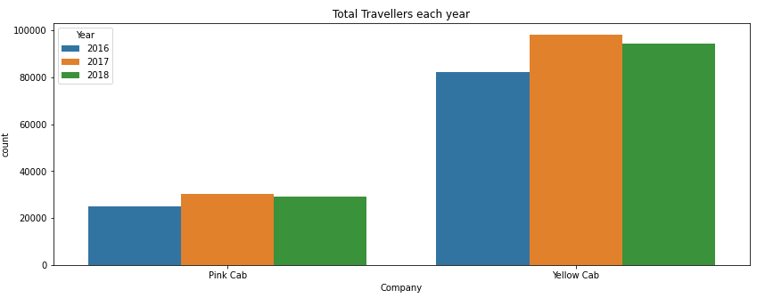
EDA: Yearly Performance
Both companies had maximum customers in 2007 and minimum customers in 2016.

Slide 7
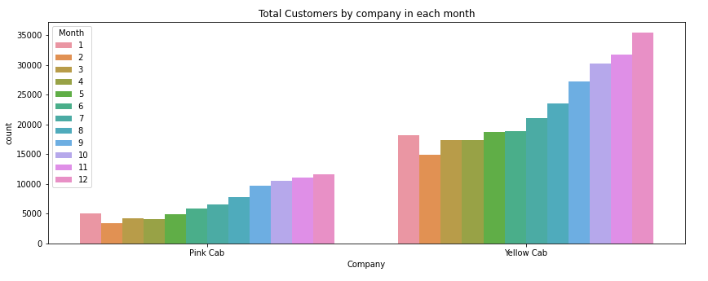
EDA: Monthly Performance
The number of travelers increase in both companies with the month.
The maximum numbers of customers are seen in December for both companies.

Slide 8
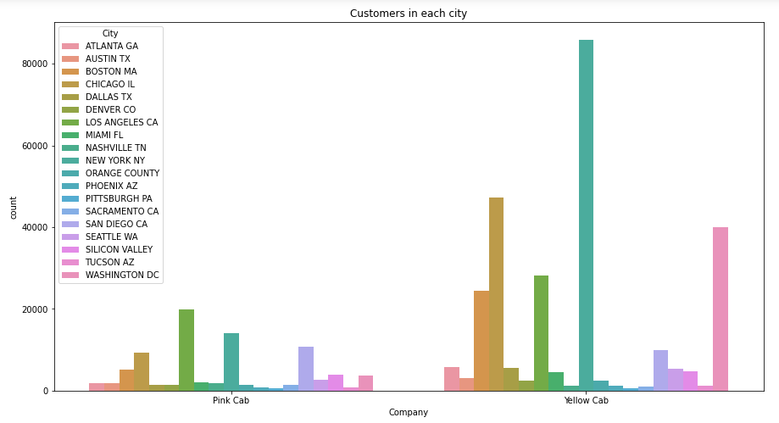
EDA: Locations Overview
The Yellow cab is quite popular in New York NY (more than 80000 people travelers) and Chicago IL and Washington DC compared to Pink cab.

Slide 9
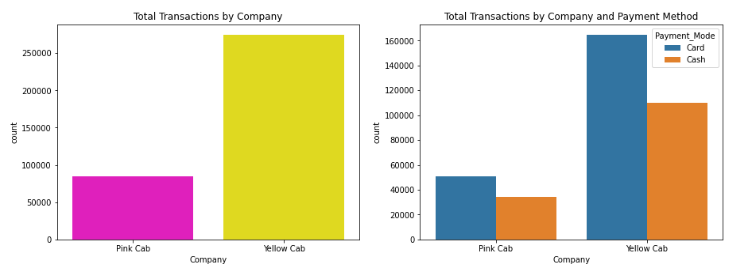
EDA: Transaction Overview
The yellow cab company has significantly more transactions than pink cab.
Users of both cab companies prefer to pay using card rather than cash.

Slide 10
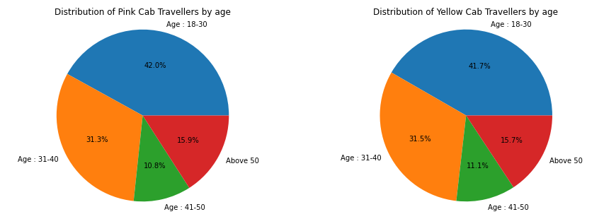
EDA: Age of travelers
It is evident that both have almost the same proportions of age groups travelling.
Most peoples using both cab services are young people i.e., more than 70% are below 40.

Slide 11
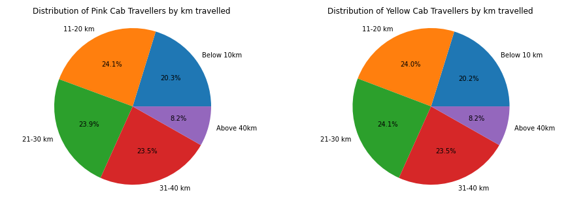
EDA: Distance Travelled
It is evident that both have almost the same proportions of distance travelled.

Slide 12
Conclusions
Yellow Cab has more travelers than Pink cab and hence is more profitable.
There is more proportion of male travelers than female in both companies.
Users of both companies prefer using card as a payment method.
New York, Chicago and Washington DC have the maximum number of travelers.
The majority of cab riders are 40-year-old or younger.
Typical car rides do not exceed 40 kilometers

Slide 13
Recommendations
Yellow is more profitable hence we recommend to invest in that company.
The ideal time to start the service is towards the end of the years because of more travelers.
Make sure that the new service accepts the card as a payment method because that is preferable.
It is recommended to target New York, Chicago and Washington DC because they are good marketplaces.

Slide 14
G2M insight for Cab Investment firm
Thank You

